Slide 1

REUNION SURVEY
2014
Notes:
Save ?s for end
We’ll put up on reunion site
Lots data – less interpretation

Slide 2
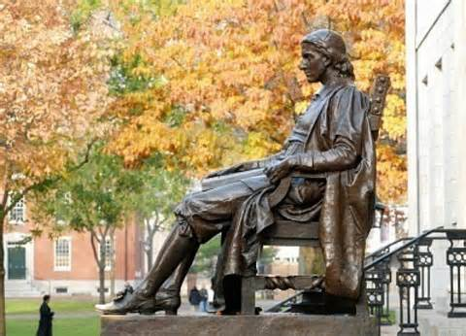
Reality leaves a lot to the imagination.
- John Lennon

Slide 3
10 Questions Not On 10th Reunion Survey
#10 Are you retired?
#9 Are you caring for a seriously ill parent of yours / your partners?
#8 Do you have any children enrolled at Harvard?
#7 Do your children stand to receive a significant inheritance?
#6 Do you have an annual prostate exam / mammogram?

Slide 4
…Continued
#5 Are you an empty nester?
#4 Did you meet your current partner on the internet?
#3 As you get older, your need for sex is..?
#2 Have you or your partner used Viagra?
#1 Have you undergone voluntary sterilization?

Slide 5
If You are Male, You are More Likely to…
Work long hours
Have held a single job / worked a long time for your current employer/have had a single career
Work in Law, Business, or Medicine
Significant household net worth
Live in the suburbs
Chosen your work for personal fulfillment
Are moderate to conservative
Be Catholic
Be unfaithful to your partner

Slide 6
If You Are Female, You are More Likely to …
Work in the arts rather than a business career
Work in the home/self-employed
Stepped out to care for the family
Live in a big city
Chose work primarily to help others
Liberal or left wing
Be faithful to your partner
You are having more sex now that the kids have left the house
Notes:
Or maybe it just seems that way

Slide 7
Demos
440 responses
32% Female
86% white, 6% African American, 5% Asian, 3% Hispanic, 1% Native American
3.2% homosexual (2% W, 4% M), 1.5% Bisexual, 95% heterosexual
Atheist and Agnostic 30%, Protestant 26%, Jewish 21%, Catholic 18%
Notes:
Woody Allen: I was the product of a mixed marriage ..father an atheist, mother agnostic, I didn’t know which religion not to believe in

Slide 8
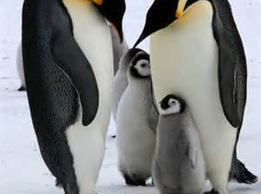
Marriage, Children, Lifestyle
Adults are obsolete children.
- Dr. Seuss

Slide 9
Current Relationship Status
  84% M and 69% W currently married
  16% M & 31% W currently not married
  Of the not married
    3% of Men, 13% of Women, Never Married
    4% of Men and Women Separated
    5% of Men and 9% Women Divorced
    1% M 2% W Widowed
    3% of Men and Women Living with Partner
Notes:
From the 25th reunion, Men dropped from 6 to 3 % never married women from 14 to 13 of never married 4% separated up from 1% for both 9% women divorced up from 4%

Slide 10
For the Married
94% of married have kids
10% M and 24% W Married to a Classmate
Met through the internet: 3% for both M&W
19% W 5% M married to someone older than 61 years old
Women more likely to be married to partner with a terminal professional degree (PhD/MD/JD/MBA): 48% W vs. 35% for M
75% W have a partner working FT vs. 44% M
Notes:
Was 20% W and 9% M at our 25th so perhaps some linkings btwn then and now

Slide 11
Intra-Class Marriages
44% married to a classmate rate their marriages “the greatest” vs. 36% for non-classmate marriages
37% classmate unions “sought counseling to improve” vs. 46% married to non-classmate unions
5% divorce rate for classmate unions vs. 29% for non-classmate unions
Divorce rate was 4% and 14% at our 25th for these two categories

Slide 12
How Happy Are Our Marriages?
48% W, 45% M “sought counseling”
13% W, 25% M report “being unfaithful”
Fraction of Classmates rating their relationship “great”
  1994: 44%
  2004: 30%
  2014: 34% (32% W 38% M)
  Divorce Rate same by gender: 27% W 24% M

Slide 13
The Not Married
Of the 19% currently not married (M 14% W 28%):
55% W and 48% M would rather be married
0% W and 22% M “not interested”
56% W and 25% M “not yet met right person”

Slide 14
Children
8% married W and 3% married M have never had kids
Of the married, 94% have children
34% M had 3 or + kids, 19% W
68% of M and W had first child before 34 yrs
5% have step-children, 8% have adopted children
11% W 18% M still have children at home
78% kids changed life “greatly for the better” 22% “mostly…” (=100%!)

Slide 15
Having Children
40% (same M & W) reported difficulties, i.e. miscarriages and stillbirths
20% W and 14% M used technology to conceive
41% W 32% M wish they had had more children
25% W and 16% M wish they had had children sooner
45% W and 56% M would do nothing differently
3% sadly have experienced the loss of a child

Slide 16
How Did We Raise Those Kids?
25% W and 5% M still stay with kids at home
43% W and 9% M did/still stay home with kids
Of those who stayed at home:
  25% W and 33% M% were/are so fulfilled
  63% W 68% M were/are delighted but glad to get back to work
  14% W and 6% M were/are frustrated

Slide 17
Those Who Didn’t Stay Home
91% M and 58% W do/did NOT stay home with their children.
  94% M and 71% W were/are comfortable with their decision
  23% W and 5% M were/are somewhat troubled
  1% M and 6% W were/are upset

Slide 18
What Do We Think About the Next Generation?
16% believe kids more capable than we were
40% believe kids are less capable of making their way in the world than we were (W 44% M 38%)
44% about the same
17% believe kids well-deserving of reputation of self-centered/entitled (W 21% M 15%)
59% somewhat deserving (W 53% M 62%)
24% not at all deserving

Slide 19
The Coarsening of Society
22% believe that the “millennials” societal behavior is no different than ours at their age – despite what our parents thought about us
78% believe that the “millennials” societal behavior is worse than ours at their age (42% “a bit worse”/28% “a lot worse”/8% “in the sewer” (12% W 6% M)
46% “don’t worry – they’ll figure it out like we did”
44% worry “a little”/10% worry “a lot”

Slide 20
Children’s Educational Paths
54% W 43% M kids in public high school
42% W 53% M kids in private high school
3% parochial
2% home schooled
57% have children attending or graduated from college
41% of those college students have attended or currently attend Harvard

Slide 21
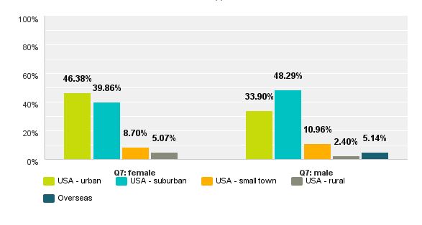
Where We Live

Slide 22
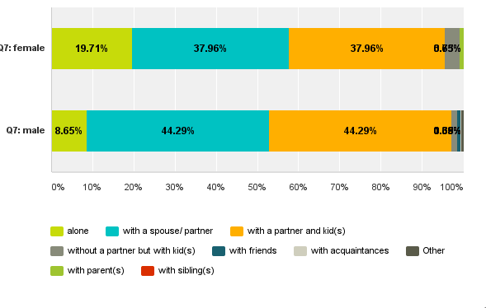
With Whom We Live
Notes:
4% W 1% M w/ kids but no partner

Slide 23
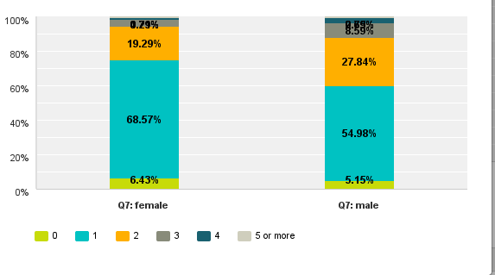
Number of Homes

Slide 24
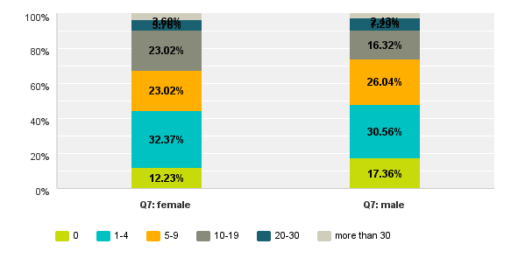
# of Hours/Week Volunteering

Slide 25
Our Health
56% Excellent (=M&W)
39% Good
4% Fair or Poor
37% had a “serious illness or injury” since ‘79
16% diagnosed with some form of cancer
5% serious heart problems
65% M annual prostate exam
80% W annual mammogram

Slide 26
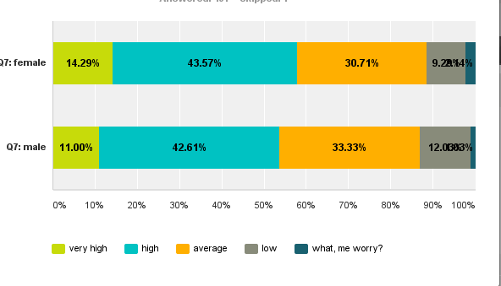
Stress

Slide 27
Our Stress Relievers
55% W 47% M 2 or less drinks per week
16% M 5% W more than 11 drinks per week
3% M=W smoke
1% W 4% M use recreational drugs
4% W 1% M treated for substance abuse
41% M 25% W spend more than 6 hours per week exercising
68% W 47% M have sought counseling
37% W 19% M have taken prescription drugs to treat depression/anxiety (same percentages at 25th Reunion)

Slide 28
Cosmetic Surgery
  Nose 3% W 2% M
  Breast 2% W
  Face 4% W 2%
  Liposuction 2% M and W
  Eyes 7% W 3% M
  Botox 6% W 1% M
  Hair 2% M

Slide 29
Comments from Women About Cosmetic Surgery
I strongly object to cosmetic surgery.
None…maybe I’d be happier if I did?
If only I’d been this smoking hot in college when I was actually trying.

Slide 30

Politics and Spirituality
Those who stand for nothing fall for anything.
- Alexander Hamilton

Slide 31
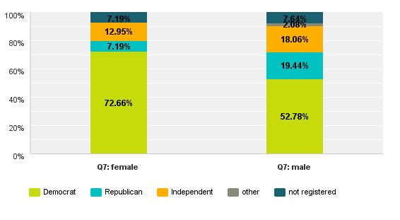
Our Party Affiliation

Slide 32
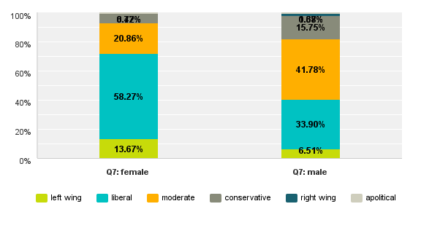
How We See Ourselves

Slide 33
How We See the Issues
88% W 70% M voted for Obama
57% W 38% M rate Obama’s terms as excellent or very good
23% M 14% W changed party since ’79
11% W 8% M believe we’ll see a 3rd party
62% W 56% M see US as better off now than 5 years ago
95% believe in abortion rights (= M&W)
49% W 35% M see income inequality as biggest threat to US

Slide 34
Other Threats: Quotes from Men
“Anti-capitalist movement”
“Political sphere too large/big government”
“Polarization of politics”
“Fiscal mismanagement/government debt”
“Gridlock”
“Regulatory and tax system”
“The terrible, short-sighted and self-centered policies of the political right-wing”
“The slow disintegration of the work ethic in our culture , the change from a society that honors achievement /courage to one that honors fame”
Notes:
ALL big Gov

Slide 35
Other Threats: Quotes from Women
“Climate change”
“Global warming”
“Gun violence”
“Dysfunctional congress”
“Intolerance”
“Republicans”
“Threats to privacy due to computer data collection/computer spying”
“Disparity in wealth/ growing divide between uber-rich and middle & lower classes”

Slide 36
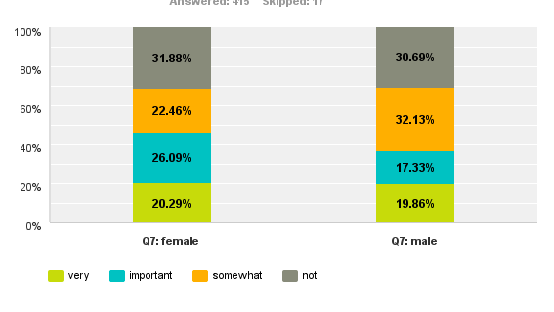
How Important Are Spiritual Matters?

Slide 37
Our Evolving Religious Beliefs
Atheist and Agnostic 30%, Protestant 26%, Jewish 21% (25% W and 19% M) Catholic 18% (21% M and 12% W)
26% W 22% M regularly attend religious services
29% W and 40% M never attend services
33% bringing up children with no religious beliefs
40% W and 37% M believe in the “god as defined by my religion”
30% believe in “no god” and 30% believe in “a higher power but not a religious god”
Spirituality decreased since ‘79 for 11% of W and 22% M
Spirituality increased for 50% W and 41% M

Slide 38
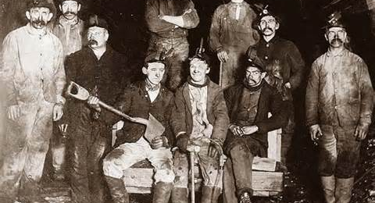
Career, Work, $$$
Don’t stay in bed, unless you can make money in bed.
- George Burns
Notes:
Relationships / family one huge arena of our lives, work the other

Slide 39
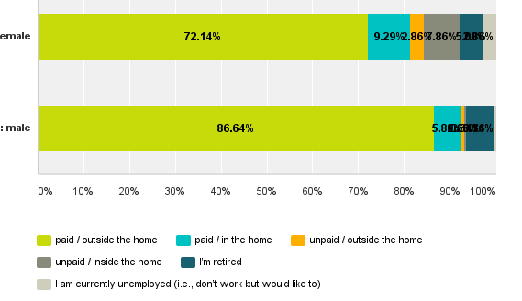
Most of Us Are Still Working
Notes:
72% W 87% M work outside the home,
11% W 1% men work “unpaid”
5% W 6% M retired
3% W unemployed (<.5% M)
At the 25th88% M and 70% W “paid and outside the home”

Slide 40
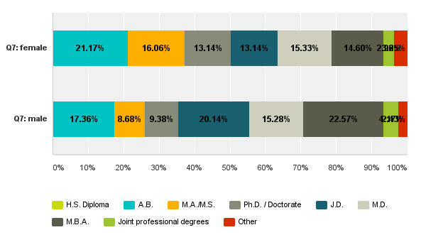
Our Education / Highest Degree Earned
Notes:
23% m v 15% W MBA
20% M v 13% W JD
15% BOTH MD
16% W Masters vs 9% M
21% W vs 17% M BA

Slide 41
Career Paths
Business: 30% M vs. 12% W
Law: 18% M vs. 12% W
Medicine: 17% for both M and W
R&D: 5% M vs. 3 W
Journalism & Communication: 5% Both
Arts: 2% M vs. 6% W
Teaching & Education: 8% M vs. 19% W
Government: 3% Both

Slide 42
How Do We Feel about Work?
13% W 4% M “don’t work for $”
Of those who don’t work for pay, 58% M 20% W retired, 39% W 5% men “care for family”
69% W 88% M work 40 hours + per week
36% W 33% M “self-employed”
32% M & W “founders”
38% W vs. 26% M changed careers two or more times
14% W vs. 4% M think they may have chosen wrong work often or very often

Slide 43
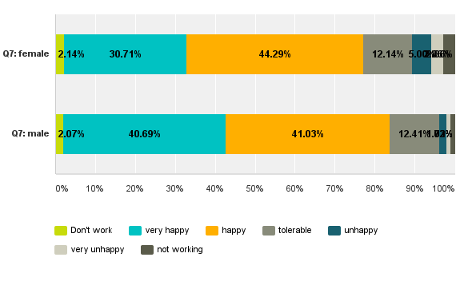
Happy With Your Work?
Notes:
So, how does all this work translate into income

Slide 44
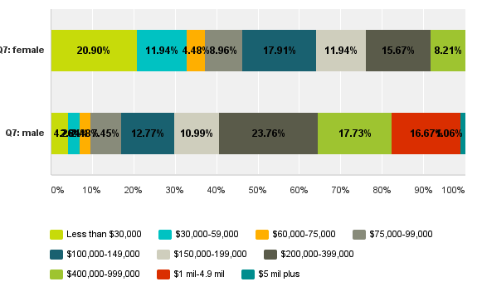
Personal Annual Income
Notes:
8% of W make over 400K, vs 35% M
18% M make > 1 mil vs 0% W
31% W make < 100K vs 17% M

Slide 45
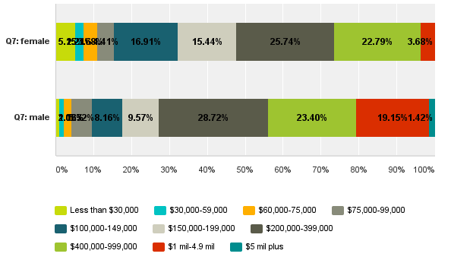
HH income – Somewhat Less Skewed
Notes:
% W in the 400+ range increases from 8.2% to 26.5%
%M in 400+ range goes from 35% to 44%
If the average woman in the class had married the average man in the class, we’d be seeing something different

Slide 46
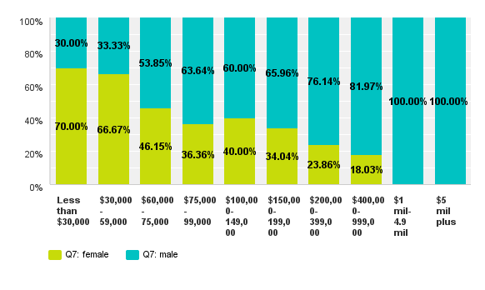
Income and Gender

Slide 47
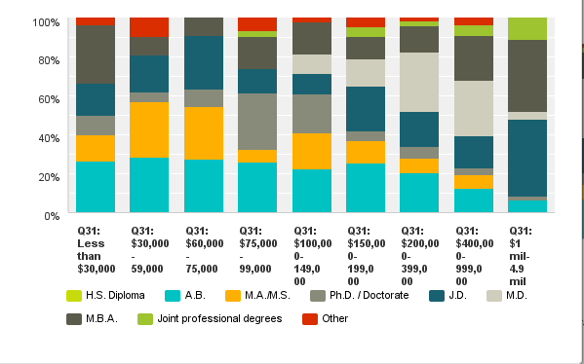
91% >$400K in Biz, Law, Med

Slide 48
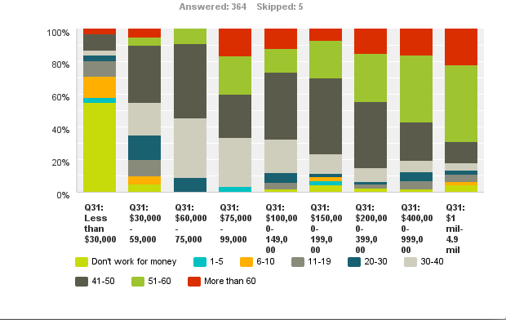
Income and Hours Worked

Slide 49
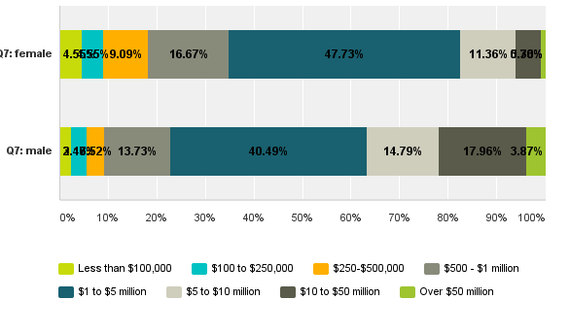
Household Net Worth

Slide 50
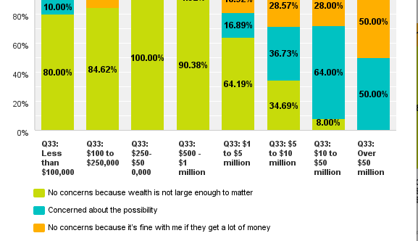
76% M 49% W Believe Kids Will Receive Significant Inheritance…Concerns

Slide 51
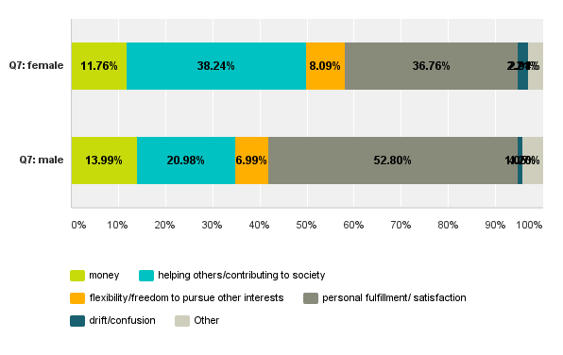
What Drove Our Choice of Work

Slide 52
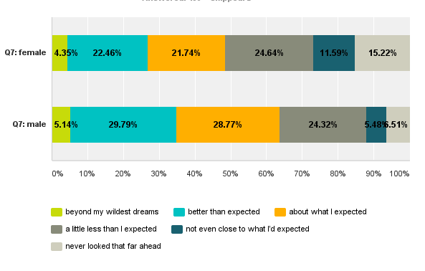
Are We As Successful as We Thought We Would Be in 1979?
Notes:
After all this talk about $$ - only interesting thing left is…

Slide 53

SEX
I’m at the age where food has taken the place of sex in my life. In fact, I’ve just had a mirror put over my kitchen table.
- Rodney Dangerfeld

Slide 54
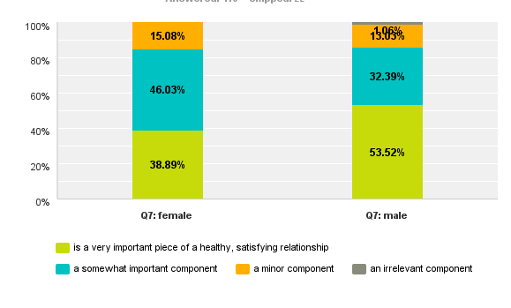
How Important is the Sexual Component of Our Relationships?
Crosstab quality of sex life on frequency
Ditto frequency on “how important is sexual component”

Slide 55
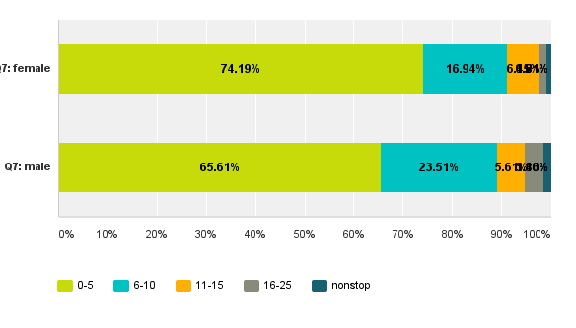
Sex Frequency
Heterosexual 96% W, 94% M
Bisexual 2% each
Homosexual 2% W, 4% M
55% of us lived w/ partner outside marriage
Notes:
40th reunion – expand the low end of the scale 0 0.5 1 1.5
Cant tell from this data alone if people are happy or unhappy w this state of affairs

Slide 56
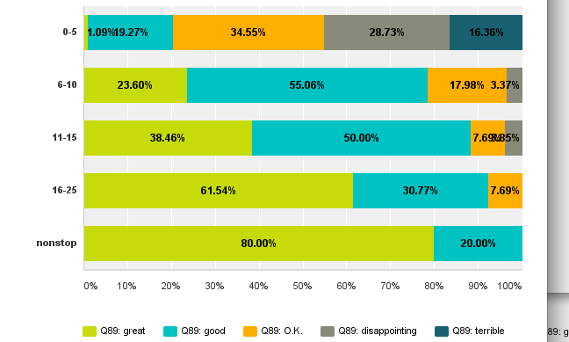
Satisfaction by Frequency
Notes:
Thru the miracle of the crosstab
I’m not a doctor, but let me tell you something people
We’ll be keeping track at the 40th

Slide 57
As We Age…
66% W and 50% M report sexual desire “decreasing”
6% W and 2% M “increasing”
38% W and 31% M who are “empty nesters” report increased frequency now that the kids are gone
28% M and 16% W report “they or a partner use Viagra or similar”

Slide 58

Exhibit A

Slide 59
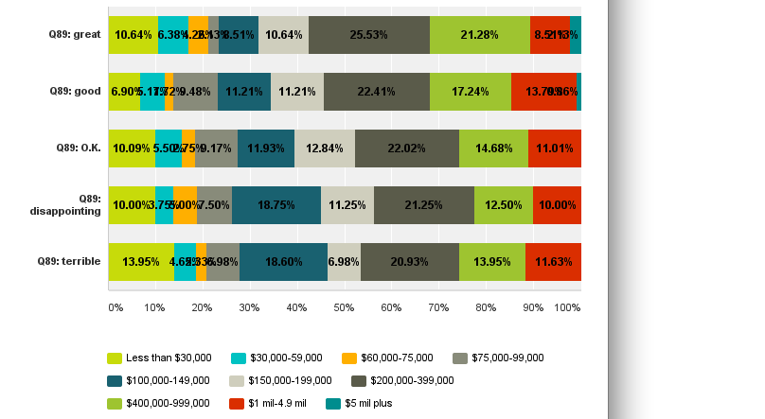
Correlation Between Sexual Satisfaction and Earnings
Largely Uncorrelated…Phew

Slide 60
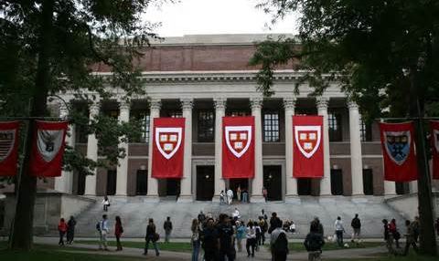
FEELINGS ABOUT HARVARD/RADCLIFFE
If you want to get (horizontally intimate), go to college. If you want an education, go to the library.
- Frank Zappa

Slide 61
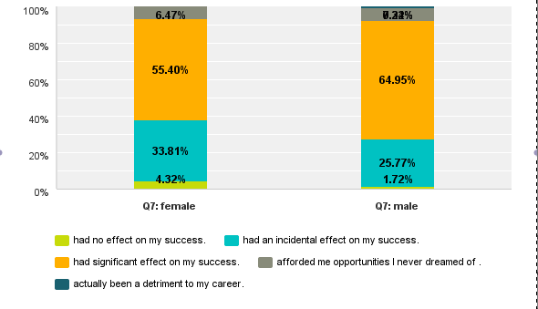
Effect of HR degree on My Career
Notes:
Male is 7.22 and 0.34

Slide 62
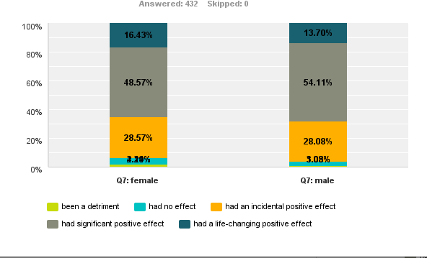
Effect of my HR degree on Personal Satisfaction

Slide 63
The HR Experience in Hindsight
Fondness, Pride, Gratitude
Lots of mixed emotions…I regret not making more of the opportunities, working harder, being more focused
Sheepishness over how much the credential is overrated in our society
I could have learned more if I had had my act together more
With the fondness that comes from the coloring of time and age

Slide 64
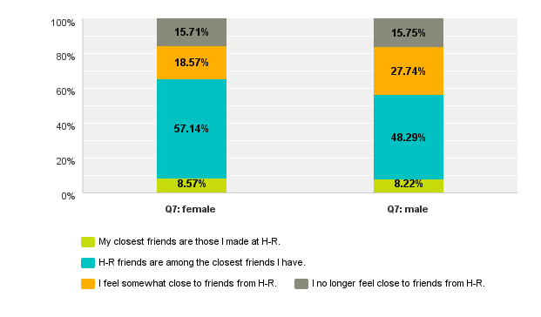
My Friends from HR

Slide 65
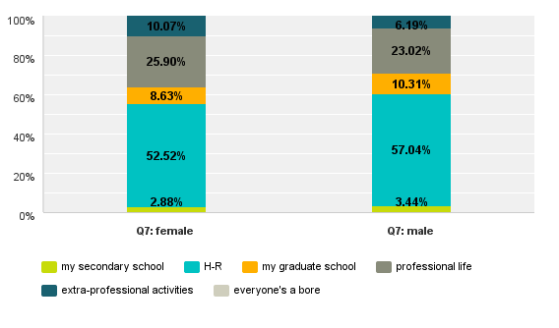
Where I Met the Most Stimulating People

Slide 66
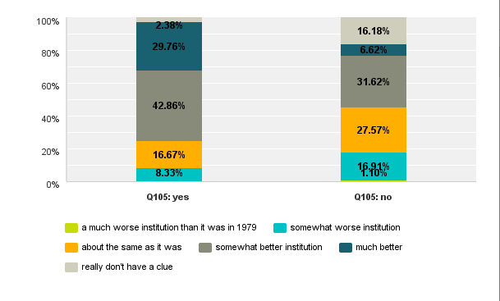
How Is Harvard Doing Today?
Harvard Parents Are Impressed!

Slide 67
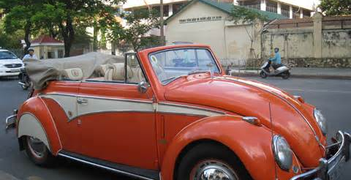
AGING
AGING
I absolutely refuse to reveal my age. What am I – a car?
- Cyndi Lauper

Slide 68
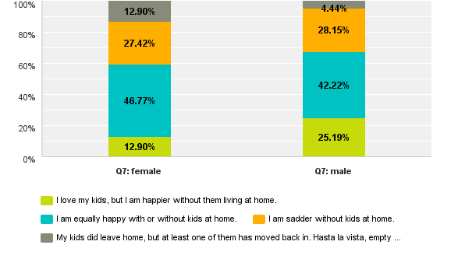
45% of Us Are “Empty Nesters”

Slide 69
The Sandwich Generation
13% W and 11% M report caring (now or previously) for a seriously ill partner
3% W and 2% men have had a partner die
30% M and 39% W have both parents alive
29% M and 25% W have neither parent alive
31% W and 12% M have reshaped a career to care for a parent
26% W and 17% M responsible for caring for a parent, i.e. visit, help fund, executor

Slide 70
Caring for Parents
I call them daily
Worry, worry, worry
Every 6 weeks I pack up my work and my computer, and take it with me the 1800 miles to my parents' place. During the ~5 days I spend with them, I telecommute to my job so I can spend the evenings and weekends with my parents, doing chores, helping with anything they can't handle on their own, lavishing them with love and appreciation.

Slide 71
Retirement
19% W and 8% M are retired = less than 20 hours per week of paid work
58% of those not retired are excited by the prospect of freedom and flexibility
36% M and 42% W are concerned about the financial dimension
22% W 11% M $$$ issues are the main reason they are not retired now
75% want to travel, 65% spend more time with friends and family/devote time to a hobby/interest
22% have an idea for a new business
54% want to support a social / political cause
65% don’t intend to move

Slide 72
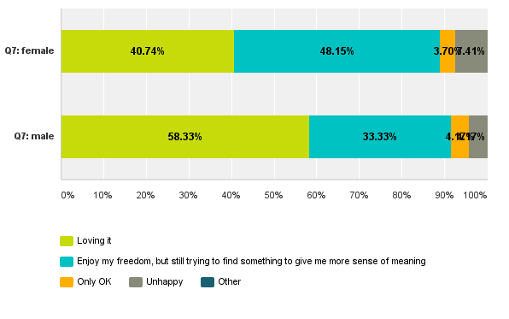
How Do the Retirees Feel about It?

Slide 73
Issues in Retirement
Lack of structure
Getting used to lack of income
Trying to describe my status to my dad
Absence of secretary
Harvard asking for money
Staying motivated
Feeling relevant

Slide 74
Advice from Retired Classmates
Don’t volunteer for everything
Pursue joy
Have structure/a plan
Go for it
Do it
Works better for people who are self-motivated
Be sure you are really ready to end your career, not just take a break

Slide 75
Retirement Time Horizon for Those Still Working
11%W and 6% M would like to retire NOW
16% in the next 5 years
32% in the 5 years after that
13% W and 10% M plan never to retire

Slide 76

THE HAPPIEST PEOPLE
Happiness often sneaks in through the door you didn’t know you left open.
- John Barrymore

Slide 77
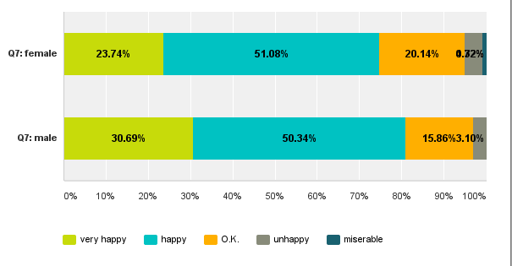
79% are “Very Happy” or “Happy”
Notes:
So – what factors seem to underly happiness

Slide 78
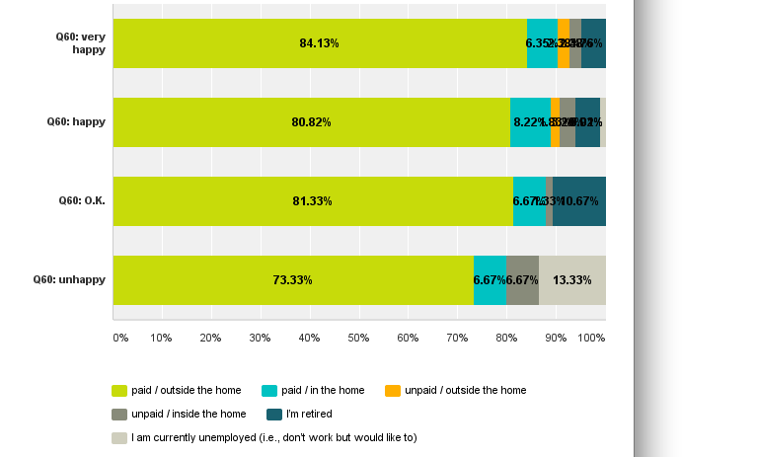
Working for $$$ Seems to Help
Notes:
72% W 87% M work outside the home,
11% W 1% men work “unpaid”
5% W 6% M retired
3% W unemployed (<.5% M)

Slide 79
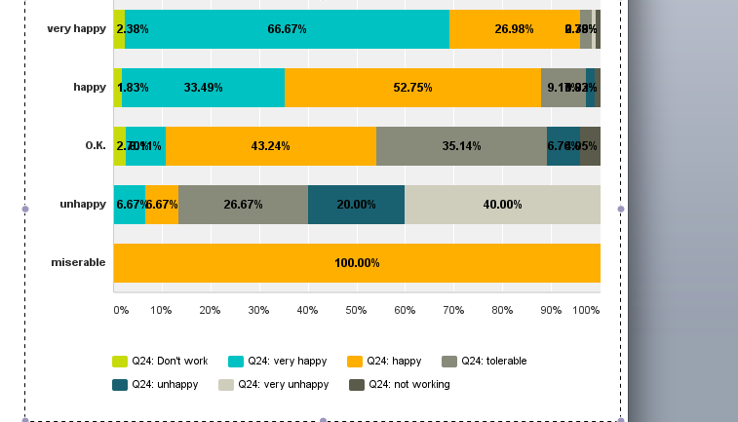
Happiness with Work Matters A Lot

Slide 80
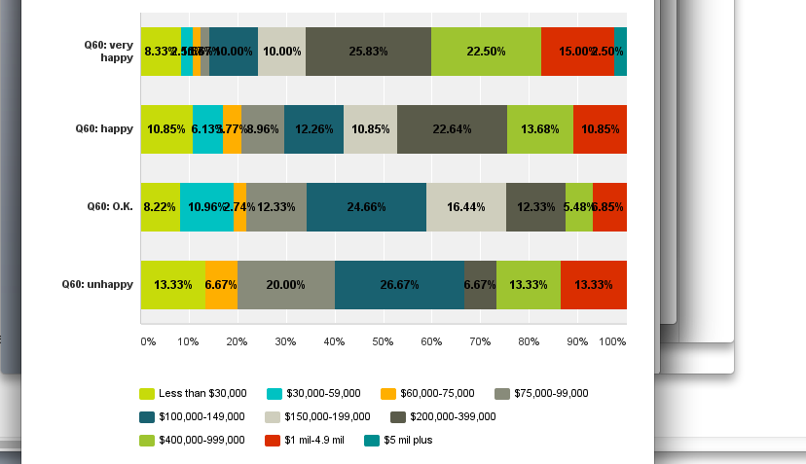
Money Doesn’t (perfectly) Correlate with Happiness

Slide 81
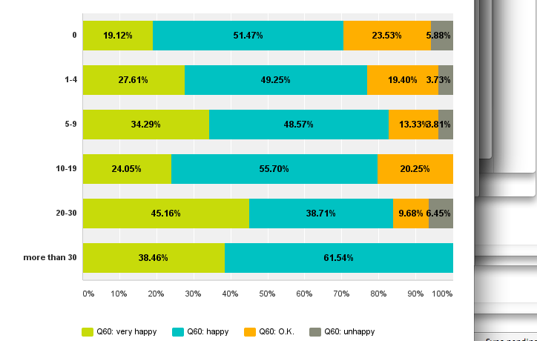
Volunteering Does Help with Happiness
Notes:
But don’t make it a full time job

Slide 82
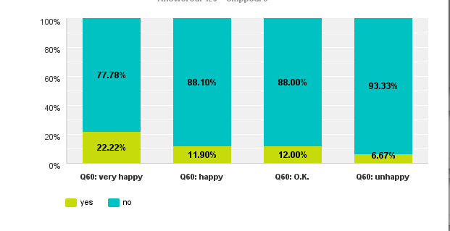
A Common Procedure Increases Being “Very Happy”
Percentage Undergoing Voluntary Sterilization

Slide 83
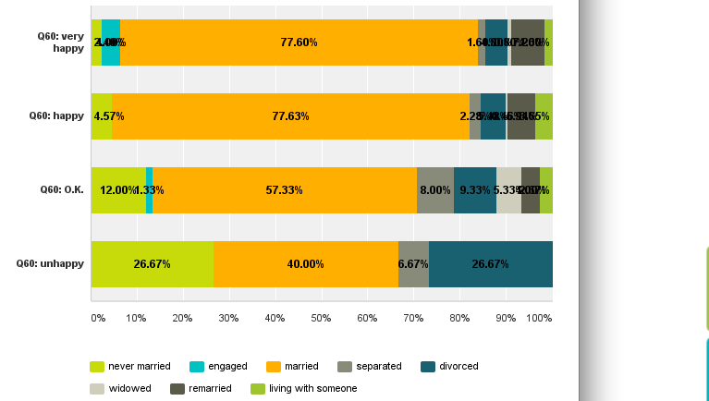
Marriage Has a Big Happiness Impact

Slide 84
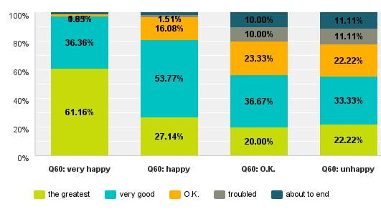
Having a Happy Marriage is Even Better

Slide 85
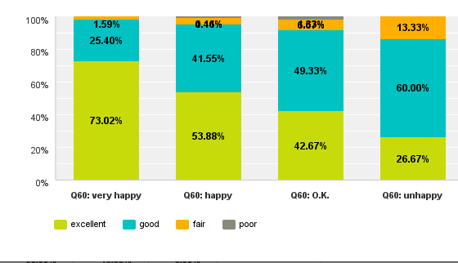
Very Healthy, Very Happy

Slide 86

OPEN-ENDED QUESTIONS
Time is long but life is short.
- Stevie Wonder

Slide 87
The Questions We Asked
Biggest surprise of the last 35 years
Biggest disappointment of the last 35 years
What change would make the biggest contribution to your happiness?
How are things different from what you imaged in 1979? What do you wish you had known in 1979?
Advice for an entering Harvard frosh

Slide 88
The Biggest Surprise: The Last 35 Years
How durable the impact Harvard's cachet has had throughout my working career and personal life
How little control we have and how one event can change everything
How quickly the time has passed
The world works the way they said it did
How liberal I have become
How flexible my definition of old can be

Slide 89
Biggest Surprise: Family
How good my husband still looks/how much I love my wife
Being able to marry my same gendered partner
I’m single/I’m divorced/I’m married/I’m remarried
How hard it is to balance work/family life
How happy I have been without kids, although I had wanted to be a mother
How much I have enjoyed being a parent
How much I want to spend time with my children

Slide 90
Biggest Surprise: Career
I'm not rich and famous
I'm richer than I ever thought I would be
I have circled back to my true passion late in life and succeeded
Careers are hard/careers are fulfilling
That I enjoy teaching 5th and 6th graders as much as college students
The role of luck and serendipity in my career
How much time I've spent working for people who went to MIT!

Slide 91
Biggest Surprise: The World Around Us
Success of Fox News
A black president
9/11
The peaceful demise of the Soviet Union
The Internet/Internet porn
Bush winning in 2000, and again in 2004
We have the technology today that Star Trek imagined we would have in 2300
Red Sox winning not 1 but 3 championships

Slide 92
Biggest Disappointment: Career
How people can be so underhanded and dishonest when large sums of money are involved
I didn't find a way to make my career more satisfying or intellectually challenging
Being downsized
Self-imposed pressure to accomplish goals instead of enjoying the journey more
The realization that the only way to be a successful and respected woman in the workplace is to be nasty and self-centered

Slide 93
Biggest Disappointment: Relationships
That I didn't structure my life to play with my family more
That my children have special needs and I worry about their ability to become independent
The death of my partner/the loss of my child
I fret incessantly over our lovely adult children; I am shocked and disappointed that life is not as easy for their generation as it was for ours
I failed in a marriage/I’m single
Not marrying the love of my life when I could
Not keeping up with college friends

Slide 94
Biggest Disappointment: The World
Around Us
Our country's political leadership
How vapid and coarse American culture and society have become
that technology has been directed way too much to creating useless distractions that make the technologists a lot of money and make the rest of us passive consumers of crap
The corruption of people in powerful positions in society
The failure to deal with climate change
The decline in social and economic justice
The re-election of President Obama
Success of Fox News

Slide 95
Someone Who Had a Lot to Say
The way we rolled back the energy independence and conservation goals of the Carter era. If we'd stuck with them we would be in a MUCH better situation now. I also think Gore was lawfully elected President and the Supreme Court was wrong to intervene and put GW Bush in power. Having said all that, I obey duly constituted authority and this whole thing where the right wing noise machine is encouraging people to consider our government illegitimate is super un-helpful. Certain problems are best tackled by the public sector. (rant)

Slide 96
Someone Who Spoke for Many of Us
I’m disappointed that I didn't make more money sooner. It's minor, because I have made quite a bit of money, but given what I do and how well I do it, I expected that I would have made a lot more by now.
I also wished they had learned how to make pets talk.

Slide 97
The Biggest Contribution to My Happiness Would Be…
Predictable cash flow/financial stability
My start-up business takes off and provides financial security
Money. Don't kid yourself!
Lower taxes
To go out and start a business
Profound Republican failure in the midterms
Weight loss (15…25…35 pounds)
A new neck

Slide 98
Biggest Contribution to My Happiness Would Be…
To meet someone and re-marry
More sex/more interesting sex
Continued, balanced success of my kids
To feel that my younger daughter is well on her way being a productive , independent member of society.
To see my sons happy with their lives and with their life partners and kids
A closer relationship with God
Failure of Fox News

Slide 99
How Is Life Different vs. View in ’79: Family
I'm widowed. Never expected that
I accept myself much more fully. When I graduated I was a lesbian, but in the closet about it. Now I have been living "out" for a long time and it's no big deal. That feels great
Everything. I thought I'd get married to the perfect man, have perfect easy kids and be happy

Slide 100
How Is Life Different vs. View in ’79: Family
That I derive most of my life satisfaction from my family as opposed to career accomplishments
Losing my wife early, and having to make my way on my own
I'm a married gay father
My life is more ordinary than I'd expected it to be

Slide 101
How Is Life Different vs View in ’79: Work
I never imagined being in industry and earning a very substantial income
I value humor and values more, and intelligence and wit less
I had no idea that I would be part of the "Establishment" i.e. a major academic medical center – that I would enjoy it and be so fulfilled
Didn't imagine the level of material success that we have achieved
How much time I spend staring at a computer screen

Slide 102
I Wished I Had Known in 1979
How unexpected is the course of life
Fully commit/go for it/don’t be afraid
The value of a professional degree
Have more fun
Get started on a career path sooner/find out what you really care about/stick with an easy career
The importance of social skills/intimate relationships/personal relationships

Slide 103
I Wished I Had Known in 1979
There is always a creative alternative
Be more forgiving
The importance of humility and humor
It’s hard to raise children and have a satisfying career
Financial hindsight: compounding assets, real estate, equities (cellular stocks, tech stocks, Microsoft, Apple)
The joy of a great marriage and family

Slide 104
I Wished I Had Known in 1979
I am capable…I am exceptional…I don’t need fixing
Computer science would be where the action is
That great love would come…and require daily attention
Happiness is something you can create
How much the decisions in my twenties would determine my life path

Slide 105
I Wish I Had Known in 1979
That it was a waste of time to be so concerned about what others think of me
When I chose an academic career, I thought I was going to a cozy place – haha! It's a vipers nest!
It is harder to raise children and have a satisfying career than I expected
The importance of focus in developing a career/the importance of finding out what you really care about vs. anything else

Slide 106
I Wish I Had Known in 1979
How erratic and unpredictable life is, and the best parts of life are the parts that happen despite our best-made plans, rather than because of them
The need to determine career plans rather than just to let life happen
That the color of my skin would be more important than my education, hard work, or my character
I didn't have to rush to see the Rolling Stones; I could still go see them 35 years later

Slide 107
I Wish I Had Known in 1979
Making money is not a terrible thing
Being cool is not a life plan
How easy it would have been to make my parents happier
To be more strategic about professional development
How much I had left to learn about life
I think I could have gone out with more girls… I shouldn't have been so shy!

Slide 108
In 1979, I wish I’d Known…
Deep personal connections and sense of peace/happiness are more important than professional/intellectual achievement
In college, the answer to the philosophical question – would you rather be a pig satisfied or Socrates dissatisfied – I would have answered Socrates; now, the pig
How the days seem long but the years are short

Slide 109
I Wish I Had Known in 1979…
How quickly we would lose the older generation and how much I would miss them
It's hard to be a libertarian egalitarian in a hierarchical and somewhat imperialist society
That there's no single point in one's life after which one has everything together; even my parents were faking it! But the process of learning and growing is the point, and it's fun
To find a husband in college
Tempus fugit – spend your time carefully

Slide 110
I Wish I Had Known in 1979… Practical Advice
Stay out of the sun
Diet is more important than I realized
Keep on exercising regularly/find better ways to stay fit
Don’t stress
Get less angry
Take better care of your knees!

Slide 111
I Wish I Had Known in 1979…Finally
Money is more important than I thought it was at that point
There are things that are more important than money
The Harvard faculty is so overwhelming and reflexively liberal that you need to study conservative ideas on your own to understand them, even if you decide to reject them

Slide 112
Life Advice for the Harvard Class of ‘18
Pursue your dreams
Take risks
Be content with who you are
Live within your means
Don’t confuse intelligence with wisdom
Worry is a waste of time
Hard work trumps talent
Give back
Don’t be too impressed with yourself
It’s all going to work out; have fun

Slide 113
Life Advice for the Harvard Class of ‘18
Drink very little and network
Pick people, not courses or jobs; look around you and find people who are doing something that resonates in your heart and take little bits from each of them to infuse into your creation of a path through life
The world will change profoundly during your life; be prepared to be flexible
Keep your eyes open for a sweet, lovely life partner

Slide 114
Life Advice for the Harvard Class of ‘18
There is always someone smarter, luckier, more attractive, who will work harder than you; be content with who you are – figure it out as a young adult – try to improve on your weaknesses and exploit your strengths
Have fun and enjoy yourself, go to therapy to get rid of the guilt about it
The more you think you are better than other people, the more life will ultimately kick you in the butt, as it should

Slide 115
Life Advice to Harvard Class of ‘18
Give up perfectionism and chill a little
Know what you want to do before you get to Harvard
Don't worry so much – and let yourself experiment personally and professionally
Be open to all possibilities and remember that you'll likely never be surrounded by so many smart, interesting people as at Harvard College

Slide 116
Life Advice for the Harvard Class of ‘18
Exploration is great in both career and relationships, but procrastinating is not. The clock is ticking. The sooner you can get on a path that looks promising in career or family, the further you get before the clock runs out
Be open to options; your career & life will take many turns over the next 25 years, so don't be afraid to take a chance or two
Major in what you like; don't worry about anything, because worry is interest paid in advance on a debt that rarely comes due

Slide 117
Life Advice from a Spiritual Angle
Acknowledge your Creator
Learn about Jesus/experience how he can provide life
Read about humanism
My philosophical bent brought me…to adopt Orthodox Jewish practices
Every day that God grants us is a gift
“To ease another’s heartache is to forget one’s own” – A. Lincoln

Slide 118
Biggest Surprises for the Survey Team
The incredible variety of paths/experiences in the last 35 years – even though we started with a common experience
Even though our “achievements” propelled us into H-R, our relationships now define us: 76% said their legacy would be defined by their relationship to their partner/children/colleagues
The wealth opportunity for the Class of ‘79 was continuing on to professional school; 85% of those with net worth over $5MM earned an MBA, JD, joint degree, or MD

Slide 119
Biggest Surprises for the Survey Team
The differences between men and women, in careers, wealth, and worldview:
Glad about Harvard attendance – 79% W vs. 89% M
Live with others – 80% W vs. 91% M
Spouse/partner is 60+ years old – 73% W vs. 47% M
Work 40+ hours/week for pay – 52% W vs. 78% M
Exercise 6+ hours/week – 25% W vs. 42% M
Net worth $5MM – 17% W vs. 37% M
Left wing or liberal – 72% W vs. 40% M
More increase in spirituality – 50% W vs. 41% M
Less decrease in spirituality – 11% W vs. 22% M

Slide 120
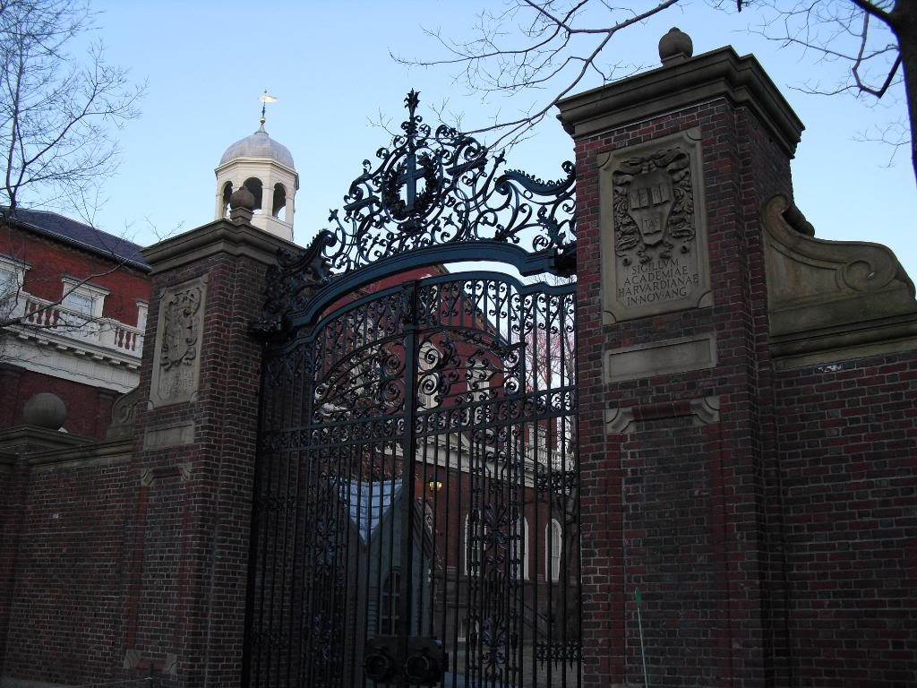
Take care of all your memories, for you cannot relive them.
- Bob Dylan

